Slide 1
Chapter 10
Organizing for Innovation

Slide 2

TEACHING OBJECTIVES
1. Develop an understanding of the impact of size and structure on a firm’s ability to innovate and implement new technologies.
2. Investigate how different dimensions of organizational structure affect a firm’s ability to innovate.
3. Understand the unique factors that affect the choice of the management of multinational innovation.

Slide 3
Overview
A firm’s size and structure will impact its rate and likelihood of innovation.
Some structures may foster creativity and experimentation; others may enhance efficiency and coherence across the firm’s development activities.
There may also be structures that enable both simultaneously.
Some structural issues are even more significant for the multinational firm.

Slide 4
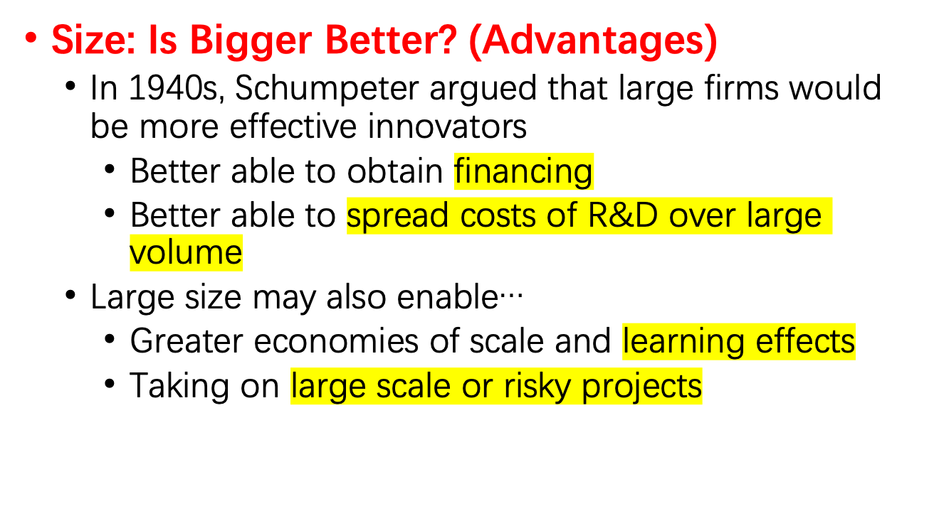
Size and Structural Dimensions of the Firm

Slide 5
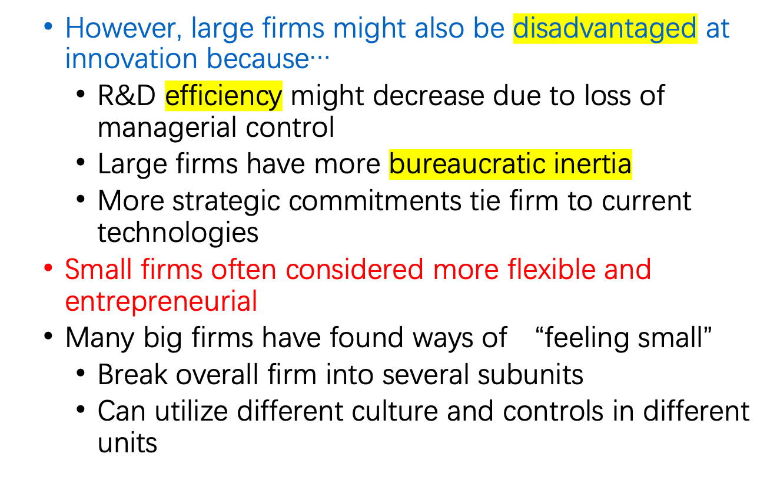

Slide 6
Theory In Action
Xerox and the Icarus Paradox
In Greek mythology, Icarus was so enthralled with his exceptional wax wings that he flew close to the sun, melting his wings and crashing to his death.
Icarus Paradox: That which you excel at can be your undoing.
Similarly, in 1960s and 70s, Xerox had such a stranglehold on the photocopier market, it did not pay attention to new Japanese competitors making inexpensive copiers.
By the mid-1970s, Xerox was losing market share to the Japanese at an alarming rate and had to engage in a major restructuring and turnaround.

Slide 7

Structural Dimensions of the Firm
  Formalization: The degree to which the firm utilizes rules and procedures to structure the behavior of employees.
    Can substitute for managerial oversight, but can also make firm rigid.
  Standardization: The degree to which activities are performed in a uniform manner.
    Facilitates smooth and reliable outcomes, but can stifle innovation.

Slide 8
  Centralization: The degree to which decision-making authority is kept at top levels of the firm OR the degree to which activities are performed at a central location.
    Centralized authority ensures projects match firm-wide objectives, and may be better at making bold changes in overall direction.
    Centralized activities avoid redundancy, maximize economies of scale, and facilitate firm-wide deployment of innovations.
    But, centralized authority and activities might not tap diverse skills and resources, and projects may not closely fit needs of divisions or markets.
  Some firms have both centralized and decentralized R&D activities.

Slide 9
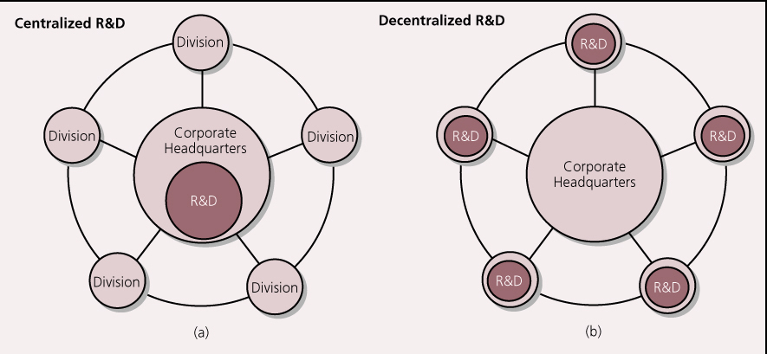
Centralized and Decentralized R&D Activities

Slide 10
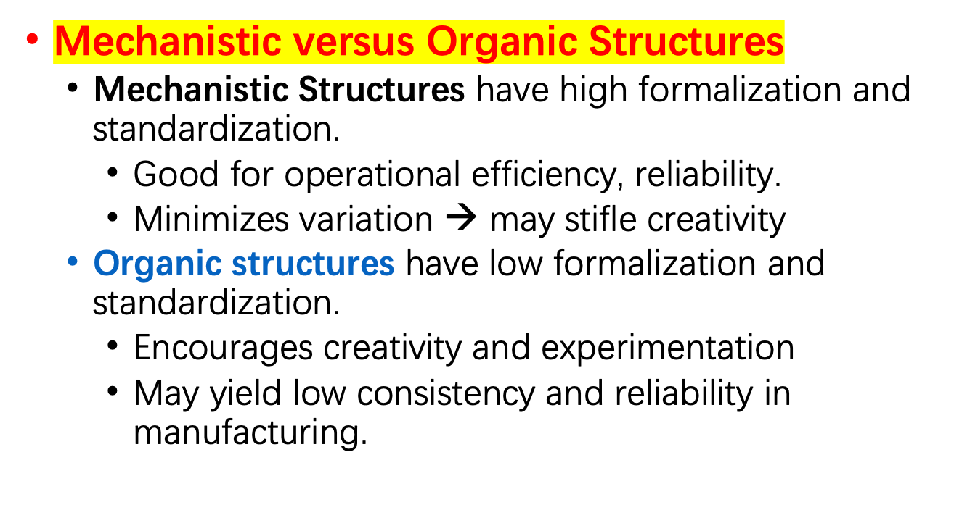
Size and Structural Dimensions of the Firm Continued

Slide 11
Organization Charts
President
Secretary
VP
VP
VP
HR Department
Financial
Department
Production
Department
Marketing
Department
Logistics
Department
After Sales
An organization chart uses a series of boxes connected with one or more lines to graphically represent the organization’s structure.

Slide 12
The Ambidextrous Organization: The Best of Both Worlds?
  Some divisions (e.g., R&D, new product lines) may be small and organic.
  Other divisions (e.g., manufacturing, mature product lines) may be larger and more mechanistic.

Slide 13
Modularity and “Loosely-Coupled” Organizations
Modular Products
  Modularity refers to the degree to which a system’s components can be separated and recombined.
  Products may be modular at user level (e.g., Ikea shelving systems), manufacturing level (e.g., Sony’s Walkman), or other levels.
  A standard interface enables components to be combined easily.
  Modularity can enable many different configurations to be achieved from a given set of components.

Slide 14
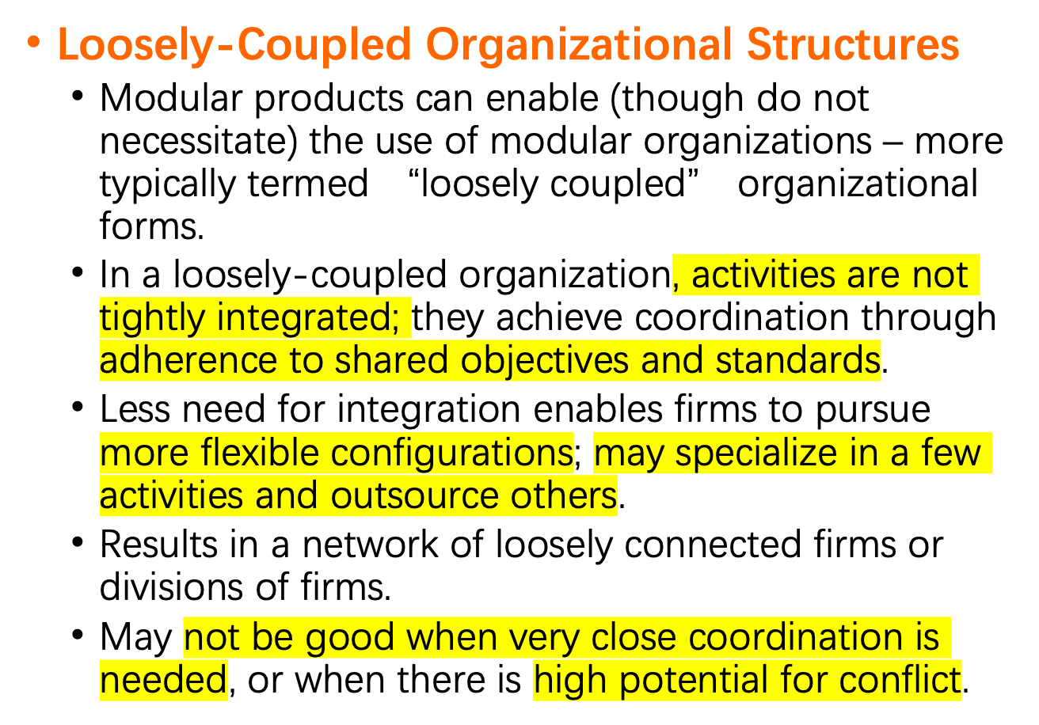

Slide 15
Theory in Action
The Loosely-Coupled Production of Boeing’s 787 Dreamliner
The Dreamliner was a super-efficient long-range mid-sized airliner manufactured primarily from carbon fiber composites that make it lighter and more fuel efficient.
The aircraft itself was designed as large individual modules that could be quickly snapped together.
The production process was also more loosely-coupled: Dozens of partners from around the world built and preassembled large pieces of the plane which were then delivered to Boeing for final assembly.
The dramatic increase in outsourcing helped to spread the risks of development, contain costs, and facilitate foreign sales.
On the other hand, the large number of suppliers made coordination more complex and lead to several delays. Boeing’s management was considering bringing more of the work back in-house.

Slide 16
Managing Innovation Across Borders
Centralization versus decentralization is a particularly important issue for multinational firms.
  Foreign markets offer diverse resources, and have diverse needs.
  Innovation tailored to local markets might not be leveraged into other markets.
    Customization might make them poor fit for other markets.
    Divisions may be reluctant to share their innovations.
    Other divisions may have “not invented here” syndrome.

Slide 17
Bartlett and Ghoshal identify four strategies of multinational innovation
  Center-for-global: all R&D activities centralized a single hub
    Tight coordination, economies of scale, avoids redundancy, develops core competencies, standardizes and implements innovations throughout firm.
  Local-for-local: each division does own R&D for local market
    Accesses diverse resources, customizes products for local needs.
  Locally leveraged: each division does own R&D, but firm attempts to leverage most creative ideas across company.
    Accesses diverse resources, customizes products for local needs, improve diffusion of innovation throughout firm and markets.

Slide 18
  Globally linked: Decentralized R&D labs but each plays a different role in firm’s strategy and are coordinated centrally.
    Accesses diverse resources, improve diffusion of innovation throughout firm and markets, may help develop core competencies.

Slide 19
Discussion Questions
Are there particular types of innovation activities for which large firms are likely to outperform small firms? Are there types for which small firms are likely to outperform large firms?
What are some of the advantages and disadvantages of having formalized procedures for improving the effectiveness or efficiency of innovation?
What factors should a firm take into account when deciding how centralized its R&D activities should be? Should firms employ both centralized and decentralized R&D activities?
Why is the tension between centralization and decentralization of R&D activities likely to be even greater for multinational firms than firms that compete in one national market?
What are some of the advantages and disadvantages of the transnational approach advocated by Bartlett and Ghoshal?

